Slide 1
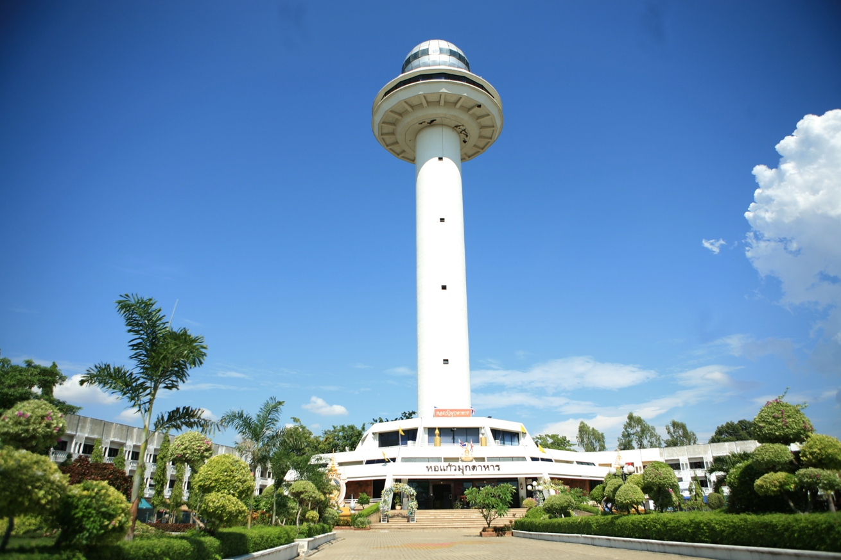
Participatory Action Research (PAR) Mukdahan, Thailand
November 17, 2010

Slide 2
Participatory Action Research (PAR)
Qualitative research that allows community members to participate, learn from each other, and address issues that threaten their livelihoods, health, and life.
Requires stakeholders to work jointly with community members
Uses inexpensive and culturally relevant tools
Rapid collection of data
Allows community members to exchange ideas and discuss courses of actions
Information is only considered valid if the same results are found using several PAR tools
Notes:
PAR is one of the methodologies that AED used to inform program intervention. It is a qualitative research that requires program managers and stakeholders to work jointly with community members. It allows community members to participate, learn from each other and effectively address issues that threaten their livelihoods, health and life. PAR can be done with inexpensive tools and can be used for data collection within a limited timeframe. By using PAR, community members can exchange ideas and discuss courses of actions. PAR emphasizes collective and individual actions and guides communities to identify practical interventions.

Slide 3
Objectives
To gain a better understanding of the community members’ knowledge, attitudes, and practices regarding acute febrile illnesses (AFI), including influenza, malaria and dengue, and its effects
To offer an opportunity for the community to exchange ideas about health issues in their communities, and determine feasible interventions to reduce disease entry
To inform the development/adaptation of behavior change communication materials for target groups
Notes:
Four basic areas of emphasis are explored: signs and symptoms of fevers, treatment seeking behavior, identifying transmission routes and blocking transmission routes

Slide 4
Discuss with central and provincial health authorities
Select sites
Develop questionnaire
Touch base with district health office
Make arrangements with community leaders
Organize PAR master training
Organize PAR training for public health officers and community leaders, community health volunteers
Prepare tools for data collection
Conduct PAR in the community
Analyze data and summarize report
Share findings
Develop communication plan
Process

Slide 5
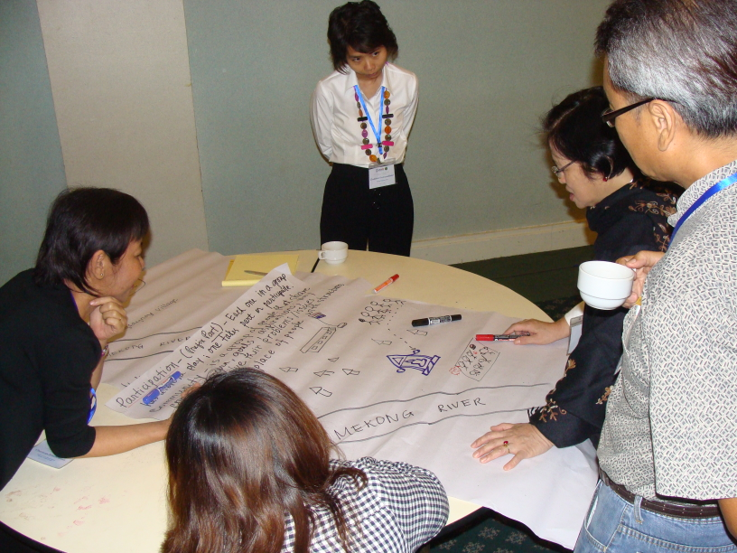
Activities
PAR Master Training
Lead facilitators were orientated and trained on PAR methodology and techniques by AED PAR expert during May 12 – 13, 2010 in Mukdahan

Slide 6
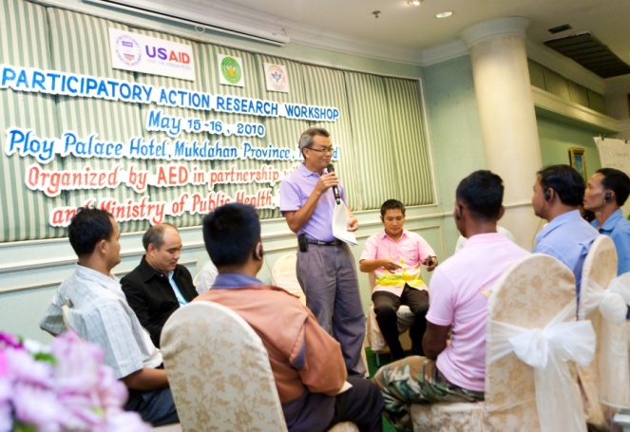
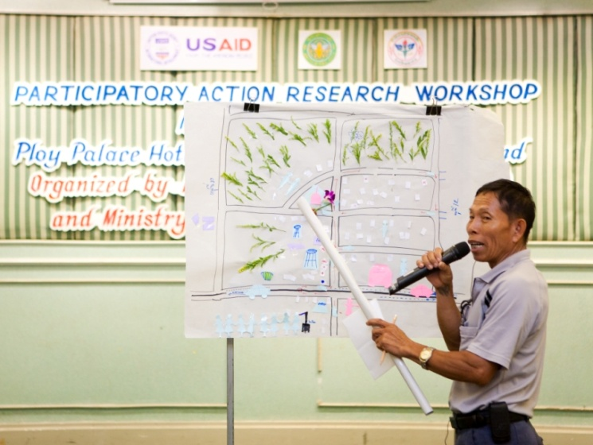
Activities
PAR Training for Local Health Officers & Community Representatives
Public health officers from Mukdahan and Savannakhet provinces,
Local authorities and village health volunteers (VHVs) from Kam Pa Lai community
Trained on PAR methodology during May 15 – 16, 2010 in Mukdahan

Slide 7
Activities
PAR Activity in Community
Four (4) villages (Moo 1, 10, 12 and 16), Kam Pa Lai Sub-district
Four (4) PAR sub-teams were formed. Each sub-team includes:
Lead facilitator
Observer (AED international staff)
Note taker (health officer)
Observer (health officer)
Note taker (villager)
Observer (villager)
Village chief/ village chief assistant

Slide 8
PAR
Kam Pa Lai Village, Muang District, Mukdahan
(18-20 May, 2010)

Slide 9
Themes/ Topics | PAR Tools
Village overview e.g. village activities, daily activities, and general village information | Focus Group Discussions (FGDs) Observation Mapping Transect Walk Daily schedule Seasonal calendar
Cross-border issues | FGDs Pie Diagram
Issue/ problem identification | Bean Quantification
Cause and recognition of symptoms | Lists of symptoms Classification of severity of each symptom (mild/ severe)
Treatment/ Home care | Flow chart and/ or Chappati Pie Gender role Individual interviews (IDIs)
Communication Channels | Pairwise ranking
Practices to Prevention | FGDs List of practices to prevention
Impact of diseases/ issues toward individuals and community | FGDs Individual interviews (IDIs) List of impact
Conclusion and “next steps” for ACTION | Causal flow diagram Force Field Analysis

Slide 10
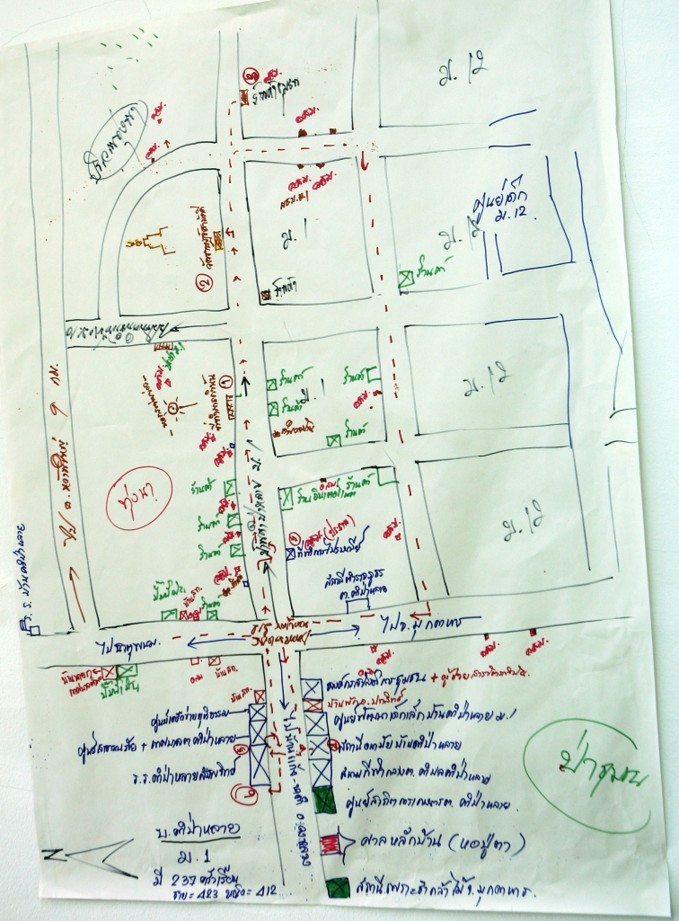
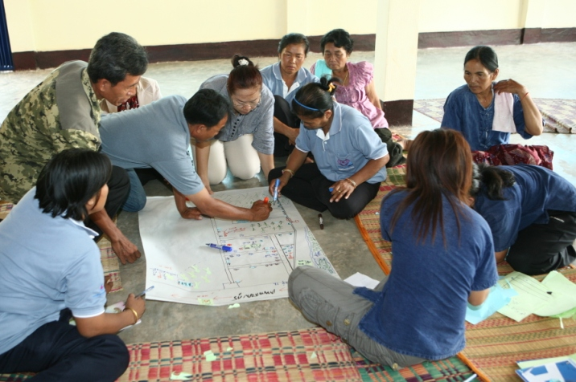
Key Findings
Village Mapping
show infrastructure
what is important to them in the village and the surroundings
boundaries of the village with the next village

Slide 11
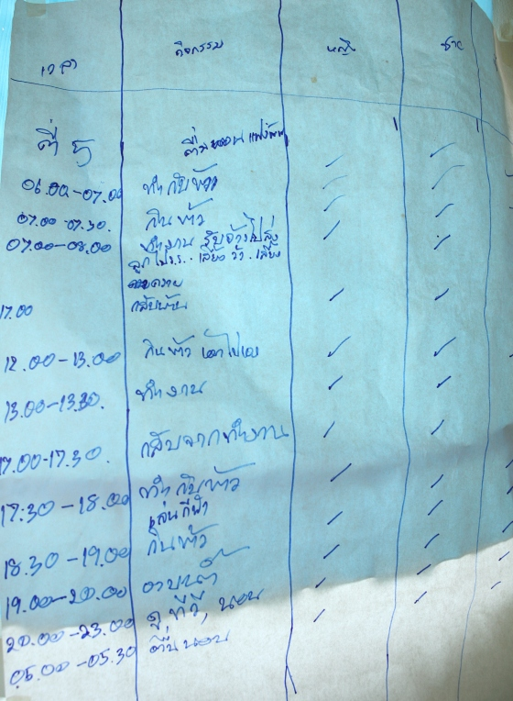
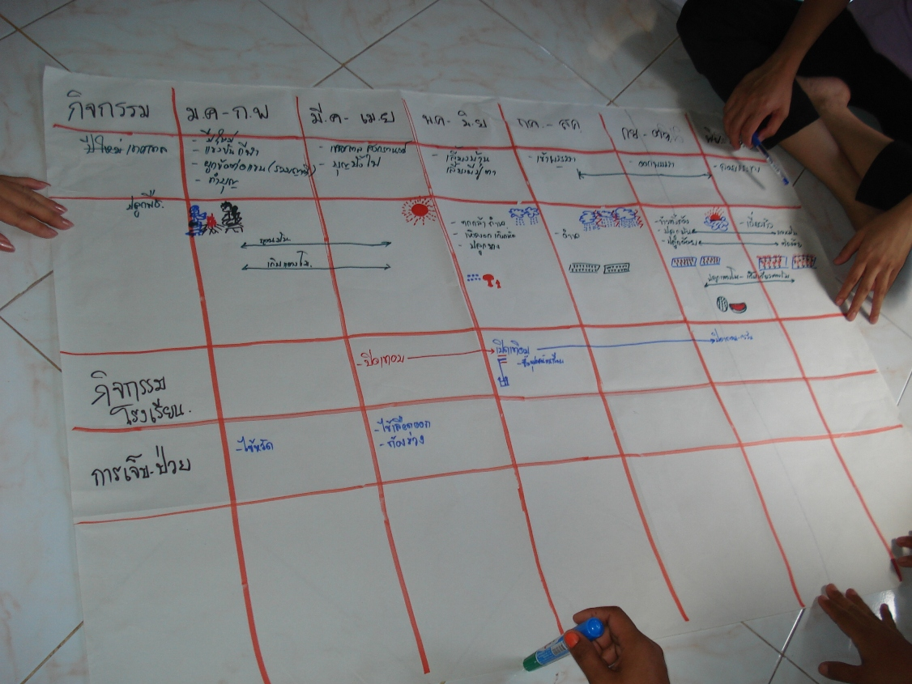
Key Findings
Daily Activities and Seasonal Calendar
Identify village livelihood
Identify periods of greatest difficulty or vulnerability in the community

Slide 12
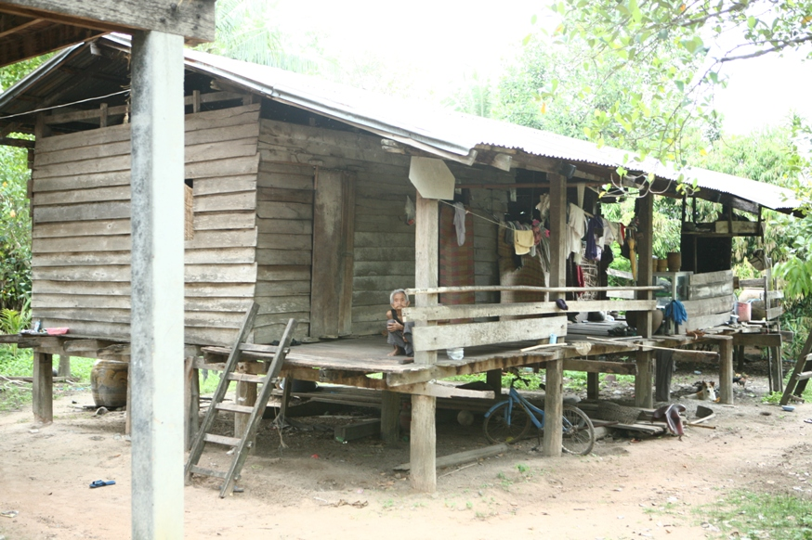
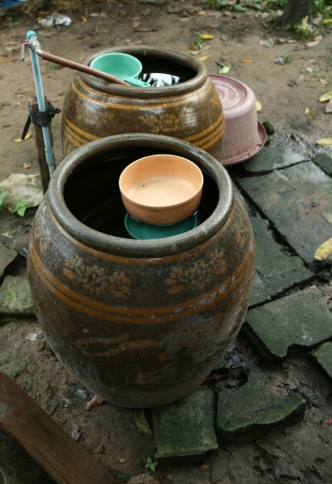
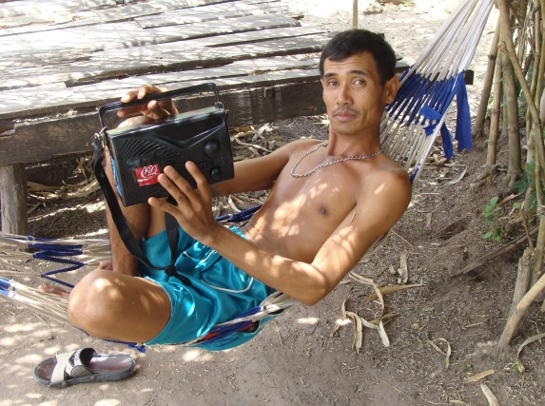
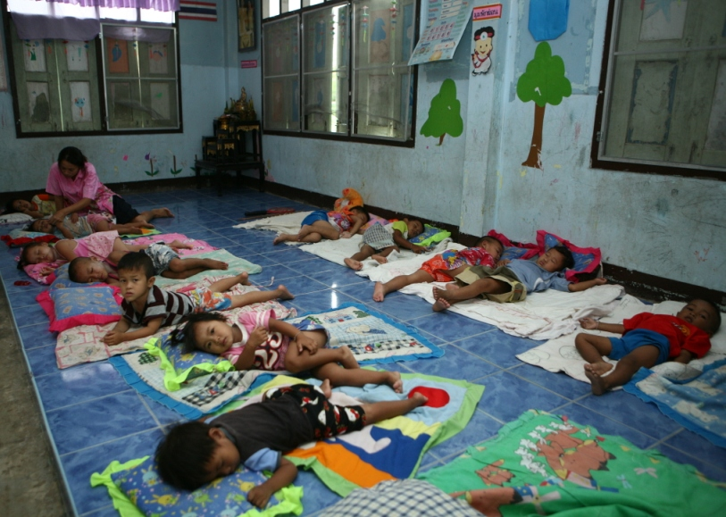
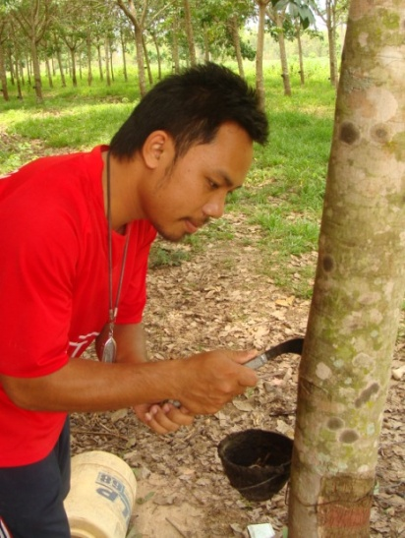
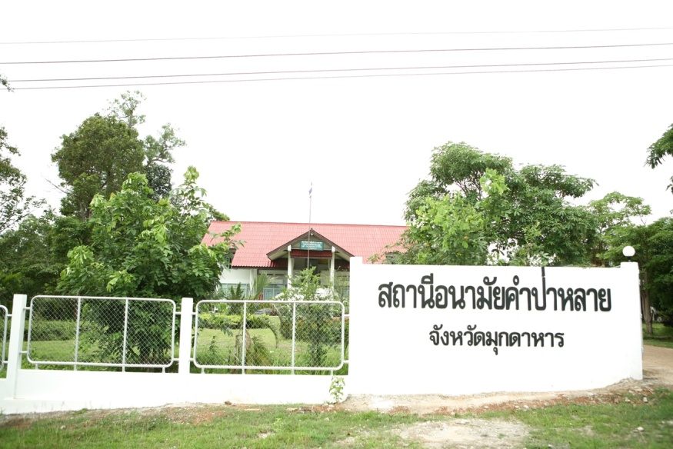
Transect Walk
Observe villagers’ behaviors and available resources in the village which were not included in the map

Slide 13
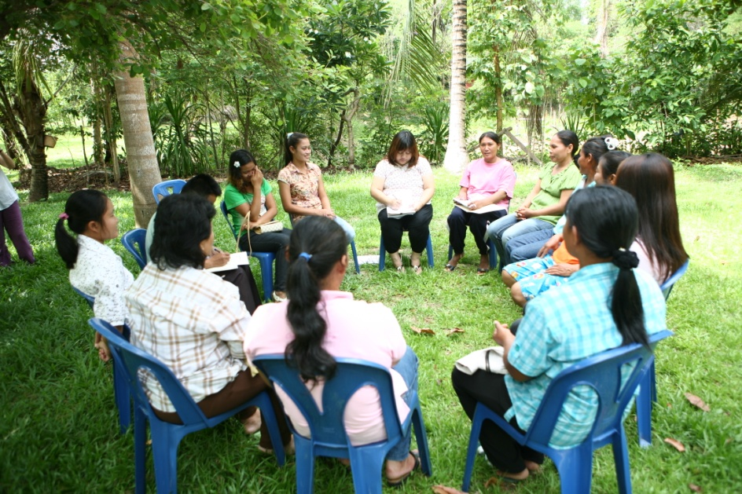
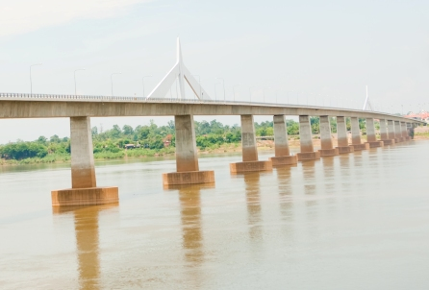
Key Findings
Cross-border Issues
Easier access between Thailand – Laos
Better economy between the two countries
More Lao people visit their relatives or work as field labors in Mukdahan during harvest season
Increased numbers of marriages between Thai and Lao people
Drugs
Gambling & crime
Increased numbers of traffic accident
Increased prices of land in Mukdahan

Slide 14
Key Findings
Issues/ Problem Identifications
Rank/Moo | Moo 1 | Moo 10 | Moo 12 | Moo 16
Men 1st | Unclean water | Dengue fever | Seasonal flu/cold | Water shortage
Women 1st | Garbage | Obesity | Dengue fever | Water shortage
Men 2nd | Dengue fever | Diabetes | Diarrhea | Garbage
Women 2nd | Obesity | Dengue fever | Diarrhea | Garbage
Men 3rd | Chemicals | Peptic ulcer | Dengue fever | Dengue fever
Women 3rd | Seasonal flu/cold | Traffic accident | Seasonal flu/cold | Dengue fever

Slide 15
Key Findings
Cause and Recognition of Symptoms (Tool: FGD)
Dengue Fever
Mild form | Severe form
Drowsiness Fever Lack of appetite Weak | Prolonged fever Rash Red spots on skin Vomiting Convulsion Coma

Slide 16
Key Findings
Treatment/ Home care: Dengue Fever
If someone in the family has “dengue fever”, they will:
Mild form → observe symptoms → tepid sponge (to cool down body) → give medication to the patients e.g. Paracetamol (bought from grocery shops within their villages) → (in the meantime) use bed nets day and night
Severe form →seek treatment from health center → (if not yet recover) → will go to district hospital (where they take dengue blood test) → if getting worse, be referred to provincial/ regional hospital

Slide 17
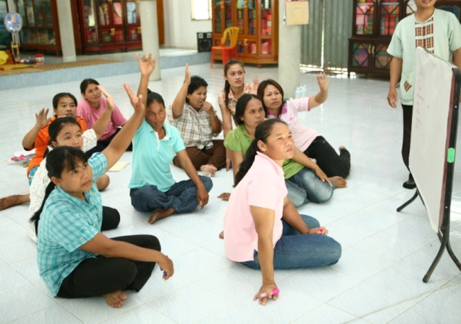
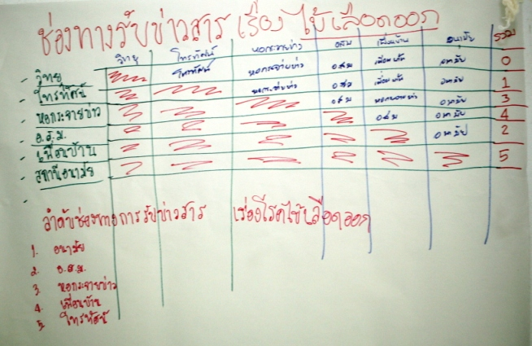
Key Findings
Preferred Communication Channels
Rank/Moo | Moo 1 | Moo 10 | Moo 12 | Moo 16
Men 1st | VHVs | VHVs | Health center | Village meeting
Women 1st | Village meeting | Health center | SMS | Village meeting
Men 2nd | Health center | Loud speaker | VHVs | Loud speaker
Women 2nd | Health center | VHVs | Newspaper/ radio | Loud speaker
Men 3rd | Loud speaker | Friends/ neighbors | Village meeting | VHVs
Women 3rd | Loud speaker | Loud speaker | TV/ village meeting | VHVs

Slide 18
Key Findings
Practices to Prevention
Prior outbreak
Clean/remove water from containers that can collect water
Use bed nets during day and night to prevent mosquito bites (& fan and wire door/window?)
Put larvae-eating fish in water containers (& temephos?)
VHVs conduct home visit to check BI, CI every Friday

Slide 19
Key Findings
Practices to Prevention
During outbreak
Report suspected cases to VHVs and/ or local authorities immediately
Spray and fog in and around infected houses
Clean the households and villages’ environment
Put Abate and Salts (?) in water containers
VHVs provide health education to community on practices to prevention and dengue fever control and visit their responsible households to check BI and CI and report results to health center

Slide 20
Key Findings
Impact of diseases issues on individuals and community
Loss of productive time to take care of sick person
Loss of income/absence from work
Fear and worry
Added expenses for treatment and care
Expenditures to buy fuel for spraying and fogging in their households and community

Slide 21
Key Findings
Force Field Analysis
Force Field Analysis
Problem | Cause | Effect | Local resources | Action
Dengue fever | Aedes mosquito | sickness, not good for mental health time and energy to care for sick persons money for treatment and care loss of income | Villagers, VHVs, leaders of village, health officers in health center, local administrative office | destroy mosquito breeding sites using fish for eating larvae Clean environment spray and fogging Cover water containers use bed nets Clean households

Slide 22
Conclusions & Recommendations
Conclusions and Recommendations
Dengue fever was mentioned in all groups among the top three priorities
Other perceived problems included seasonal flu/cold, water shortage, garbage, diabetes, obesity, diarrhea
Preferred communication channels for prevention and control of diseases included community meetings, VHVs, loud speaker and health center.
VHVs identified as most preferred persons to provide health education and health care to villagers.
Recommend to provide relevant health education and training to them
Need to improve relationship and trust between villagers and health staff
PAR technique and approaches are very useful for health officers in field to hear direct problems/ issues from the community
Timing of this PAR activity may have affected PAR findings and results since most of areas have been infected by Dengue Fever during rainy season

Slide 23
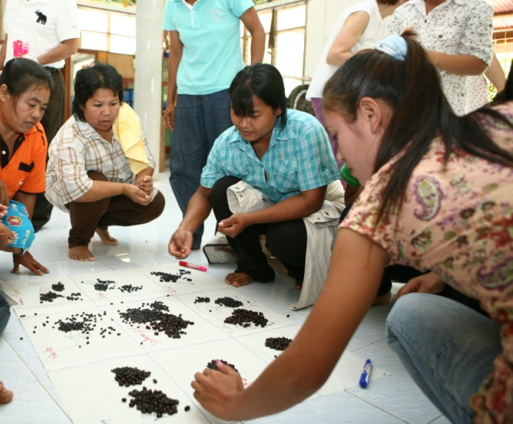
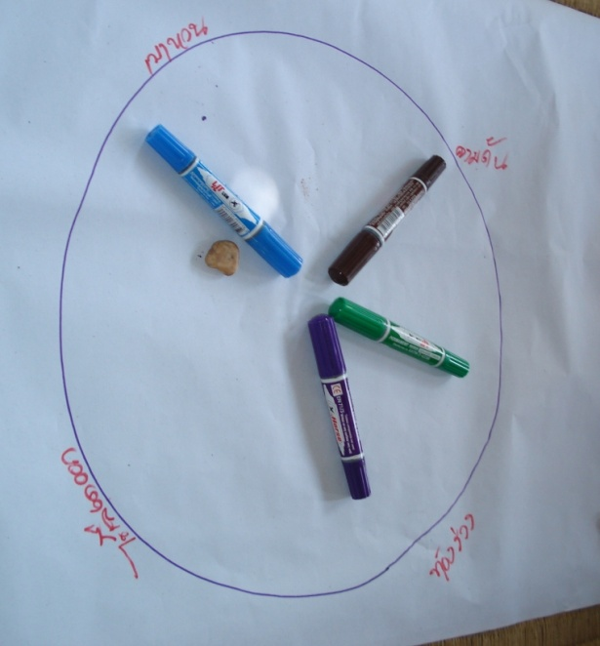
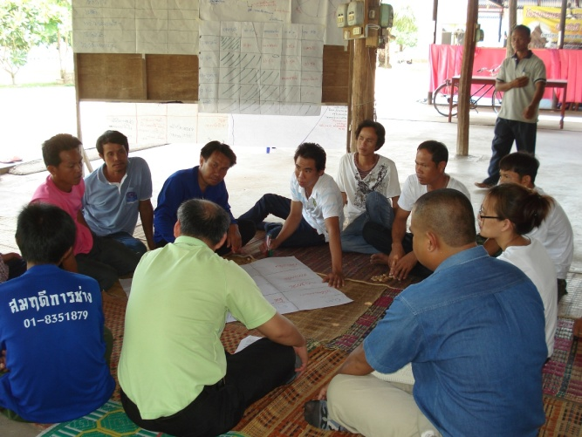
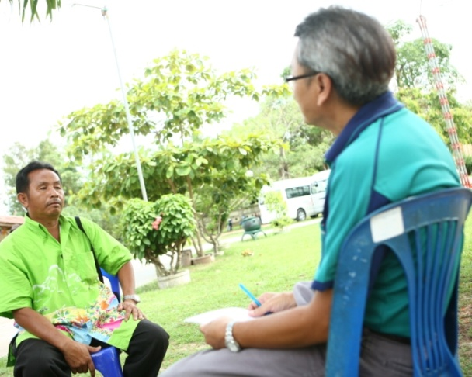
PAR Tools

Slide 24
Acknowledgements
Acknowledgements
Dr. Prapas Weerapol, Deputy Provincial Chief Medical Officer, Mukdahan Provincial Health Office
Mr. Thatchai Jaikong, Chief of communicable disease control section, Mukdahan Provincial Health Office
Mr. Krit Phantra, public health officer, Mukdahan Provincial Health Office
Staff at Kam Pa Lai village health center
Local authorities and village health volunteers of the 4 villages (Moo 1, 10, 12 and 16) in Kam Pa Lai, Amphur Muang, Mukdahan province

